Slide 1
Process Improvement Project
Matt Maloney
MBC638:38406

Slide 2
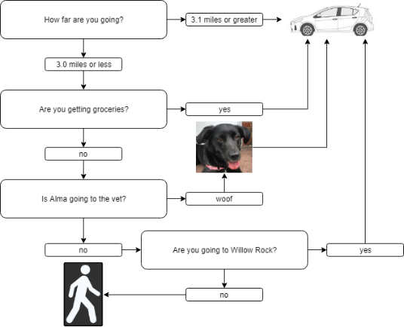
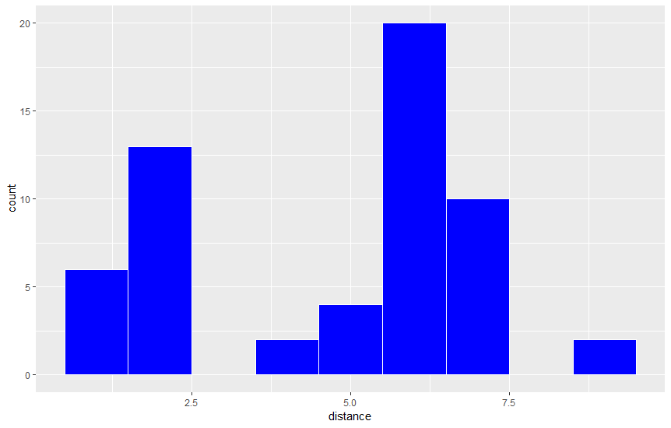
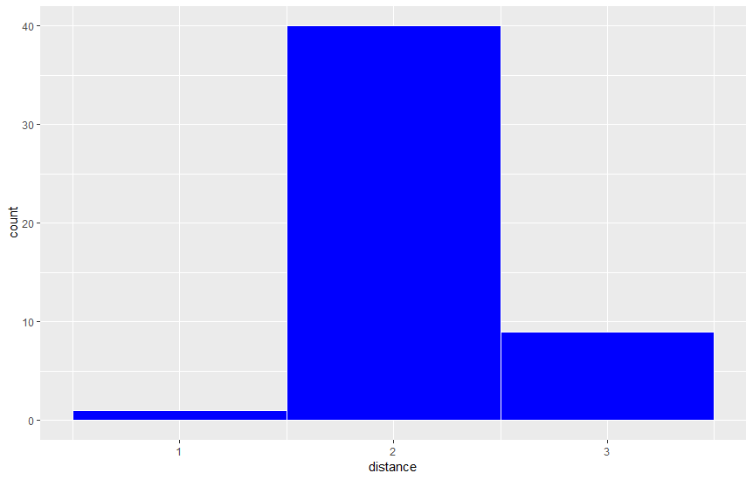
Process Improvement Project – Reducing Car Usage
Define: 4/6 | Measure: 4/6 – 5/5 | Analyze: 5/6 | Improve: 5/6 – 6/4 | Control: 6/4 –
Problem statement: I rely too heavily on my car for transportation despite living in a neighborhood not far from my office, grocery stores, restaurants, parks, a brewery, and my barbershop. I am able-bodied, have a bicycle, and there are sidewalks through most of the area. Business impact: Using the federal mileage rate, the cost to operate my vehicle over the course of the Measure phase was $158.28. Extrapolated across an entire year, this cost is $1,925.76. | Trips were taken either by foot or by car. Trips by car: Sample size: 30 days Sample mean: 9.1 miles/day Range: 48.6 miles Standard deviation: 11.4 miles Trips by foot: Sample size: 30 days Sample mean: 3.7 Range: 7.2 Standard deviation: 2.5 ------------------------------------------------- Given this data, here is the hypothesis test: Ho: 9.1 (u1) <= Mean daily car usage (u2) Ha: 9.1 (u1) > Mean daily car usage (u2) | Chi-square: 1.015 DF: 2 P-value: .602 Conclusion: There is not a demonstrable relationship between weather and mode of transportation. | While I initially assumed that weather had a large impact on the decision to walk, it is clear that distance and purpose of trip are more important variables. This led me to ask: How can I limit distance traveled? How can I increase my maximum non-car distance? How can I increase towing capacity without relying on the car? Before taking measurements during the improve phase, I tuned up my bicycle and a child carrier trailer. I have used this setup in the past for running errands but have gotten away from it. | Trips by car: Sample size: 30 days Sample mean: 1.2 miles/day Range: 11.8 miles/day Standard deviation: 3.2 miles/day All other trips: Sample size: 30 days Sample mean: 6.2 miles/day Range: 8.2 miles/day Standard deviation: 2 miles/day -------------------------------------------- Results of hypothesis test: z: 3.65 corresponding probability: .99987 p: 0
 | cloudy | rainy | sunny | total
car | 11 | 19 | 27 | 57
walk | 13 | 13 | 24 | 50
total | 24 | 32 | 51 | 107
Weather and walking not related!
We must reject the null hypothesis!
SQL: 1.5
Cluster of low mileage car trips and cluster of high mileage car trips. Do they have the same cause?
SQL: 2.6
Team: Matt, Kate, and Alma

Slide 3
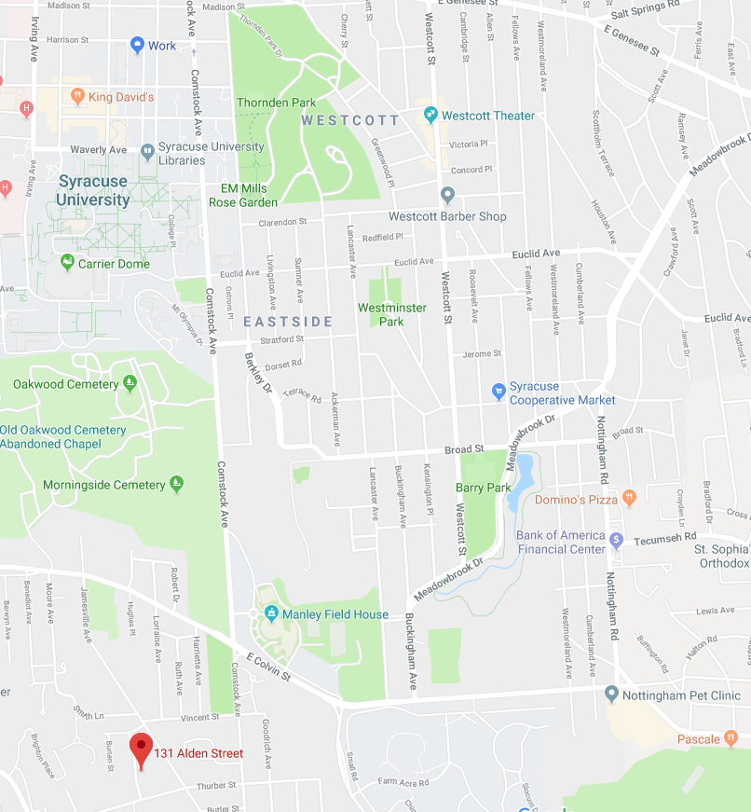
Define
My problem is relying too heavily on my car for transportation. I live in a neighborhood not far from my office, grocery stores, restaurants, parks, a brewery, and my barbershop. I am able-bodied, have a bicycle, and there are sidewalks through most of the area.
While transit by car is not extremely expensive (especially in my Prius), the costs are not zero, which leaves room for improvement. Additionally, time spent in a car is less useful than time spent walking or bicycling.
Business impact: Using the federal mileage rate, the cost to operate my vehicle over the course of the Measure phase was $158.28. Extrapolated across an entire year, this cost is $1,925.76.
Because this cost is not too high and the stakes are very low, I will consider my improvements effective if I can decrease average daily car mileage, regardless of the magnitude.
Map:
Circle: my house
Star: my office
Triangle: local co-op
Rectangle: shopping district with coffee roaster, barber, restaurants

Slide 4
Measure
Data was collected by recording the mileage and time of each trip made during the month-long measurement phase. In addition to these continuous categories, discrete data was collected about the purpose of the trip, the weather, and the destination.
There were 107 observations over a 30-day period. If we take each day as a sample instead of each individual trip, my daily car usage had a standard deviation of 11.4 miles. At a 95% confidence variable, this leaves me with a potential error of about four miles. Given that this is not a high-stakes scenario, that is fine with me.
My measurements may be imprecise, as I only measure to the tenth of a mile. Additionally, although I have tried to be diligent about recording every single trip, there may be a few observations that I forgot to log.
SQL calculation:
I will use any day in which I drive 5 miles or more as a defect
In my initial sample, there were 15 days (out of 30) where this condition was met (50%)
DPMO = 500,000
SQL = 1.5
Descriptive statistics:
Trips by car:
Sample size: 30 days
Sample mean: 9.1 miles/day
Range: 48.6 miles
Standard deviation: 11.4 miles
Trips by foot:
Sample size: 30 days
Sample mean: 3.7
Range: 7.2
Standard deviation: 2.5

Slide 5
Data stratification tree
Questions About Process
Stratification factors
X Variables
Measurements
How far do I travel?
Minutes elapsed during trip
Length of time
How much time do I spend in transit?
Distance traveled
Mode
Walking, driving, or biking
On what modes of transportation do I rely?
(Output Y)
Purpose
Purpose of errand:
Groceries
Restaurants
Work
Etc.
Does the nature of a trip dictate the mode of transportation chosen?
Weather
Weather at time of trip
Is transportation chose dependent on weather?

Slide 6
Analyze
Chi-square test for independence:
Chi-square: 1.015
DF: 2
P-value: .602
Conclusion:
There is not a demonstrable relationship between weather and mode of transportation.
If there is no relationship between weather and mode of transportation, what factors are influencing my decision?
 | cloudy | rainy | sunny | total
car | 11 | 19 | 27 | 57
walk | 13 | 13 | 24 | 50
total | 24 | 32 | 51 | 107

Slide 7
Analyze
on foot:
by car:
Histograms for trips taken on foot and trips taken by car
Here we see that distance is more likely related to the ultimate mode of transportation
Additionally, there is a cluster of low mileage trips that were still taken by car
So what types of choices am I making as I am deciding on my mode of transportation?

Slide 8
Analyze
Here is a process map for the decision process
Low mileage trips taken by car typically involve the transport of objects (groceries, one trip to the vet) or trips to the brewery (very close, but in a light industrial neighborhood that is not walkable)
High mileage trips tend to be to get groceries at stores that are further away, for miscellaneous shopping needs, or to take Alma to the dog park
What changes can be made to my routine that might allow for less driving? Two solutions come to mind: convert all low mileage trips to non-driving and further limit high mileage trips.
For the former, I tuned up my bicycle as an alternative to walking and driving. For the latter, I made a commitment to walk Alma around the neighborhood instead of going to the dog park and pledged to shop at the co-op instead of at far-off grocery stores.

Slide 9
Improve
During the second month (30 days), I made 92 trips. Again looking at individual days instead of each trip as the unit by which to evaluate, the descriptive statistics are as follows:
Trips by car:
Sample size: 30 days
Sample mean: 1.2 miles/day
Range: 11.8 miles/day
Standard deviation: 3.2 miles/day
All other trips:
Sample size: 30 days
Sample mean: 6.2 miles/day
Range: 8.2 miles/day
Standard deviation: 2 miles/day

Slide 10
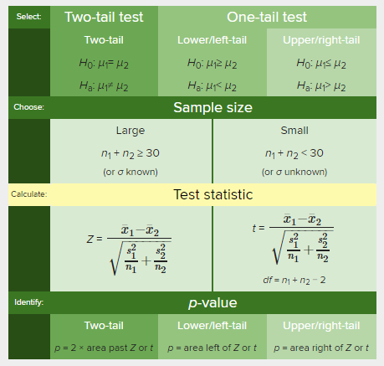
Improve
Hypothesis test
My sample data is continuous, and I am comparing an initial data set to a secondary data set (two sample)
Based on my H0 and Ha statements, I will be using an upper/right-tail test
Ho: 9.1 (u1) <= Mean daily car usage (u2)
Ha: 9.1 (u1) > Mean daily car usage (u2)
x-bar1: 9.1
x-bar2: 1.2
s1: 11.4
s2: 3.2
n1: 30
n2: 30
alpha (from slide 4): .05
results:
z: 3.65
corresponding probability: .99987
p: 0
We must reject the null hypothesis! The observed difference between the results of the two samples cannot be explained by chance alone. The changes made to the process have resulted in a statistically significant change!

Slide 11
Improve
What did I learn about my process?
Changing small habits can lead to a more active lifestyle and a less costly transportation plan
I can meet nearly all of my needs in my neighborhood
I definitely learned that I don’t get out much!
SQL calculation:
I will use any day in which I drive 5 miles or more as a defect
In my secondary sample, there were 4 days (out of 30) where this condition was met (13.33%)
DPMO = 133,333
SQL = ~ 2.6

Slide 12
Control
How will you use this information to hold the gains of improvement?
This project has raised my awareness of my own transportation habits. My bike is all tuned up and I have enjoyed shopping more frequently at our community co-operative market. While my car avoidance might not remain so extreme, I think I have made some lasting changes to my habits!

